Slide 1
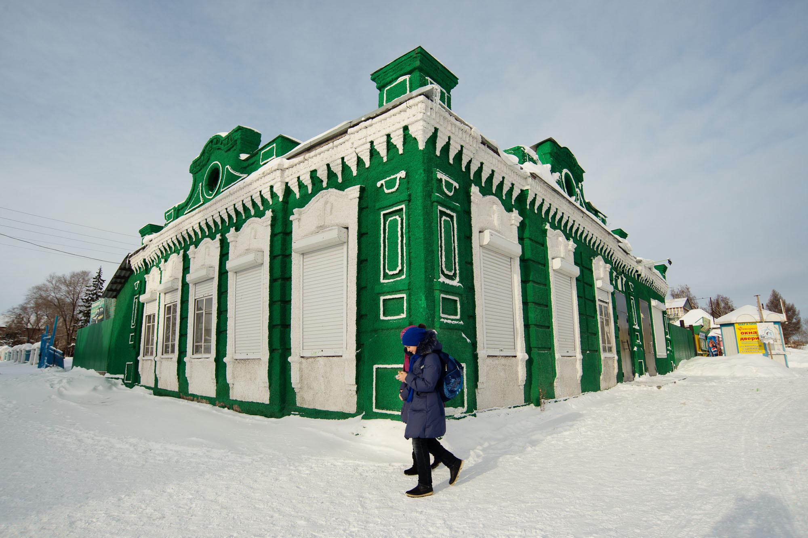
Notes:
Winter in Novosibirsk. Photo by Mikhail Koninin. (CC BY 2.0)

Slide 2
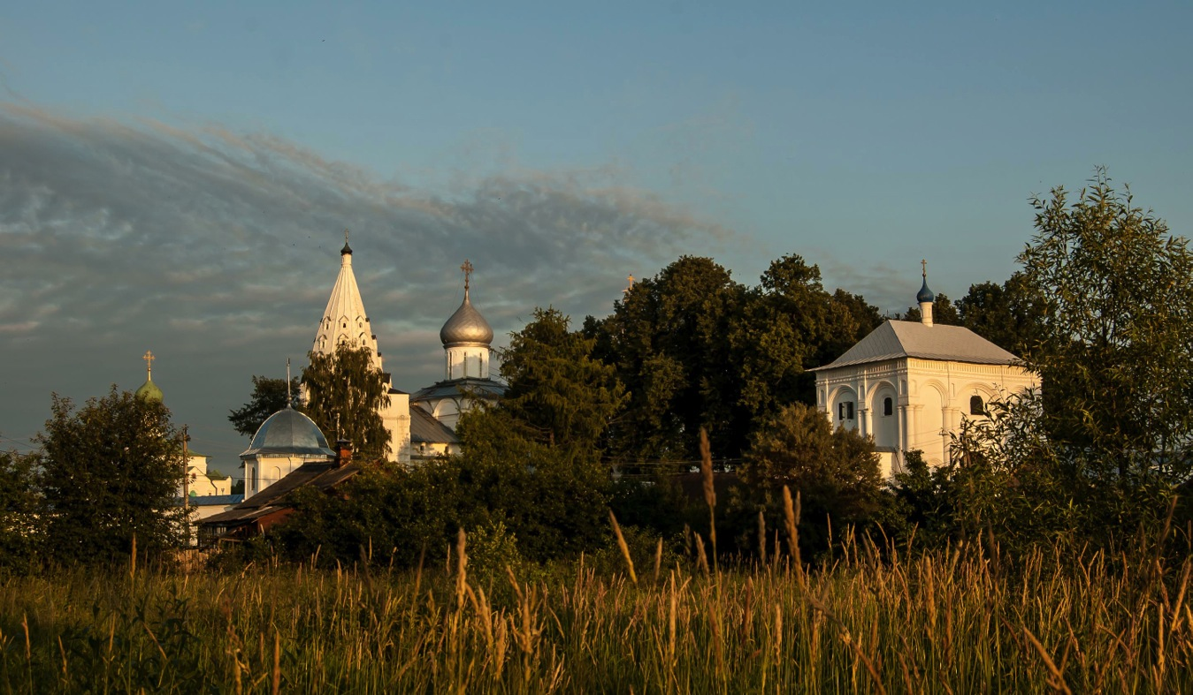
Notes:
The Troitse Danilov Monastery in Pereslavl-Zalessky. Photo by http://www.world-wide-gifts.ru/index.php (CC-BY-SA)

Slide 3
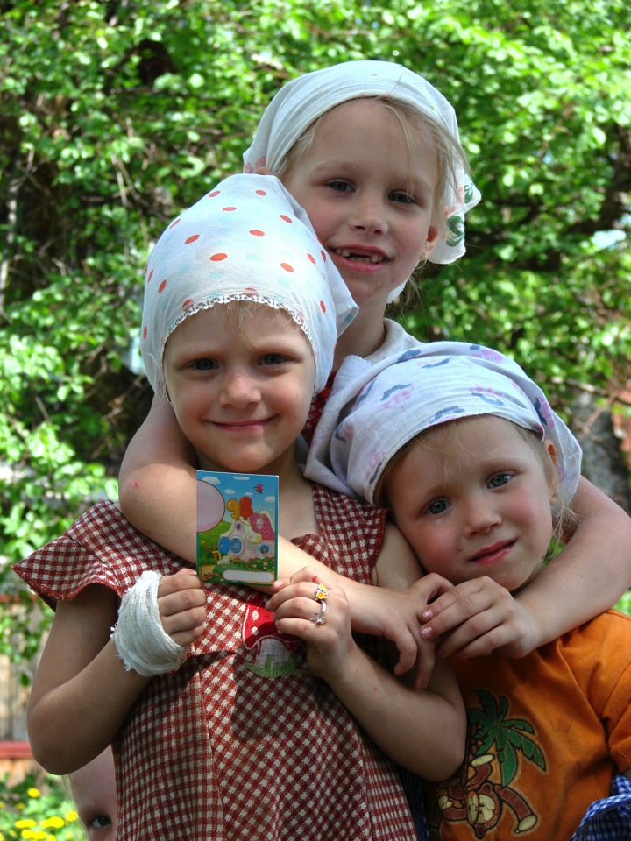
Notes:
Children in Tomsk, Siberia. June 2008. Photo by Adam Jones. (CC BY-SA 3.0)

Slide 4
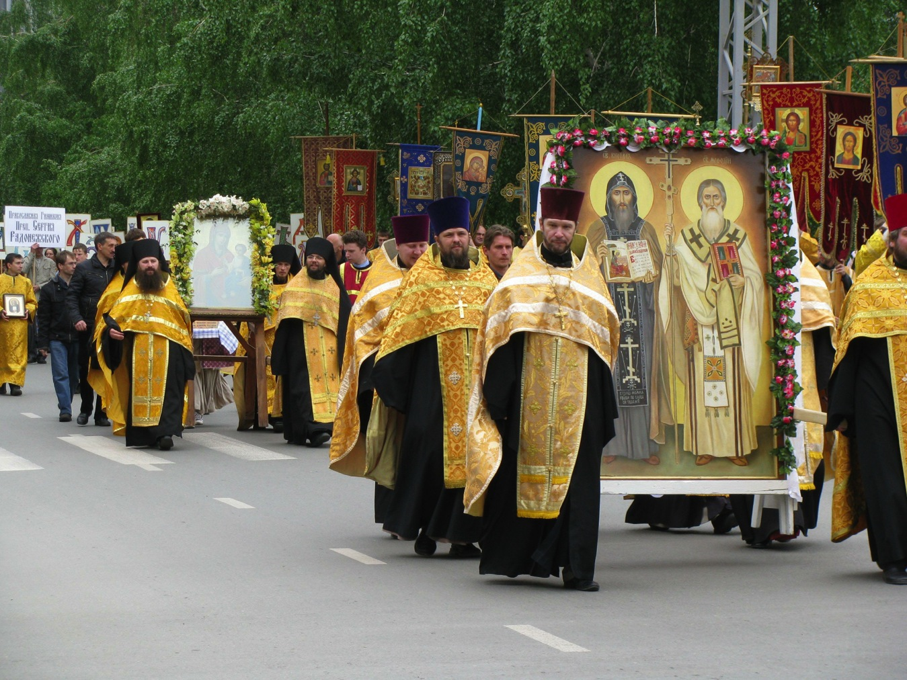
Notes:
Russian Orthodox procession of crosses. The Orthodox Church was repressed during the Soviet era and has undergone a revival since the end of the Soviet Union.
Photo by Testus. (CC BY-SA 3.0)

Slide 5
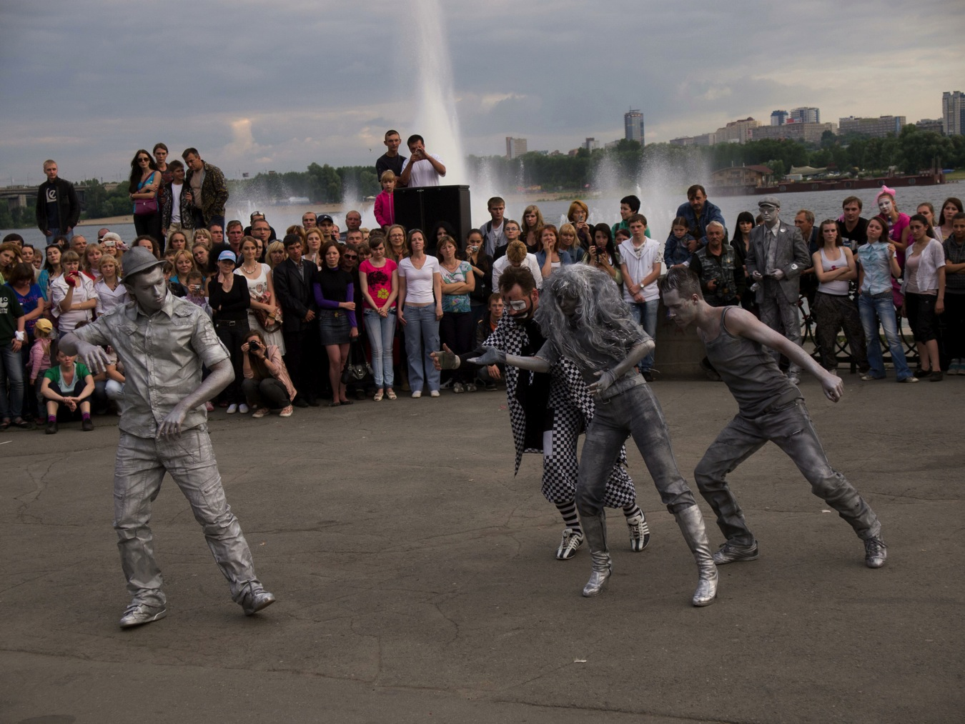
Notes:
Street performers on the Day of the City in Novosibirsk, Siberia, June 2011. Photo by MIKHAIL KONININ. (CC BY 2.0)

Slide 6
Notes:
“Epiphany bathing”. Bathing in an ice hole at the Intercession Cathedral on Nerli (Bogolyubovo village). Orthodox believers celebrating the Feast of the Epiphany. RIA Novosti archive, image #179084 / Aleksey Nikolskyi / CC-BY-SA 3.0

Slide 7
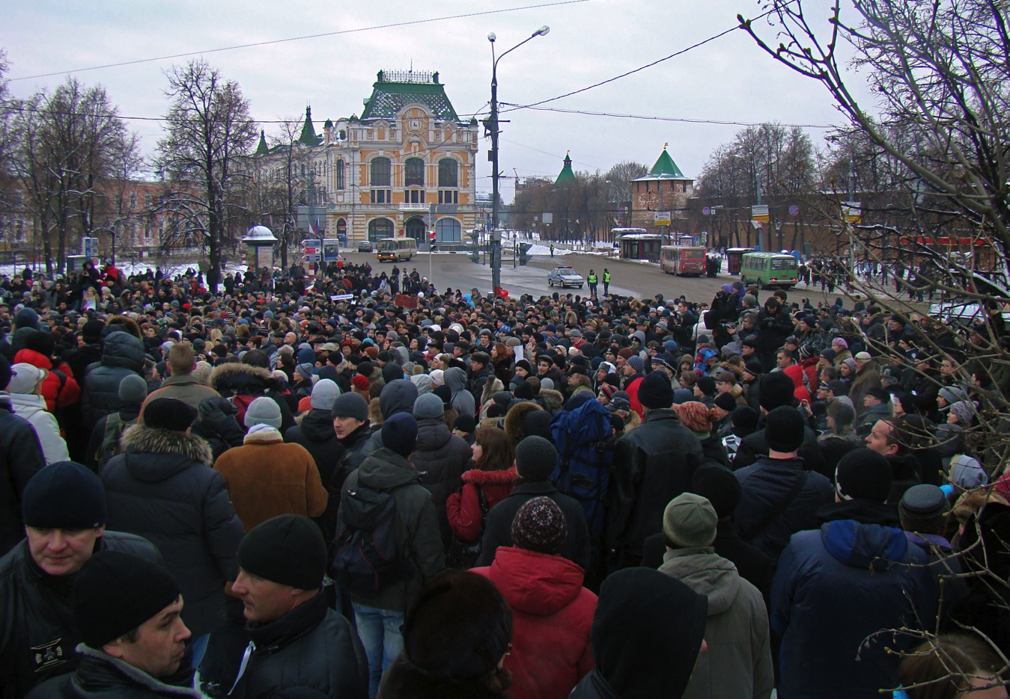
Notes:
Meeting against the official results of the Russian legislative election, Nizhny Novgorod, 2011. Photo by Bestalex. (CC BY-SA 3.0)

Slide 8
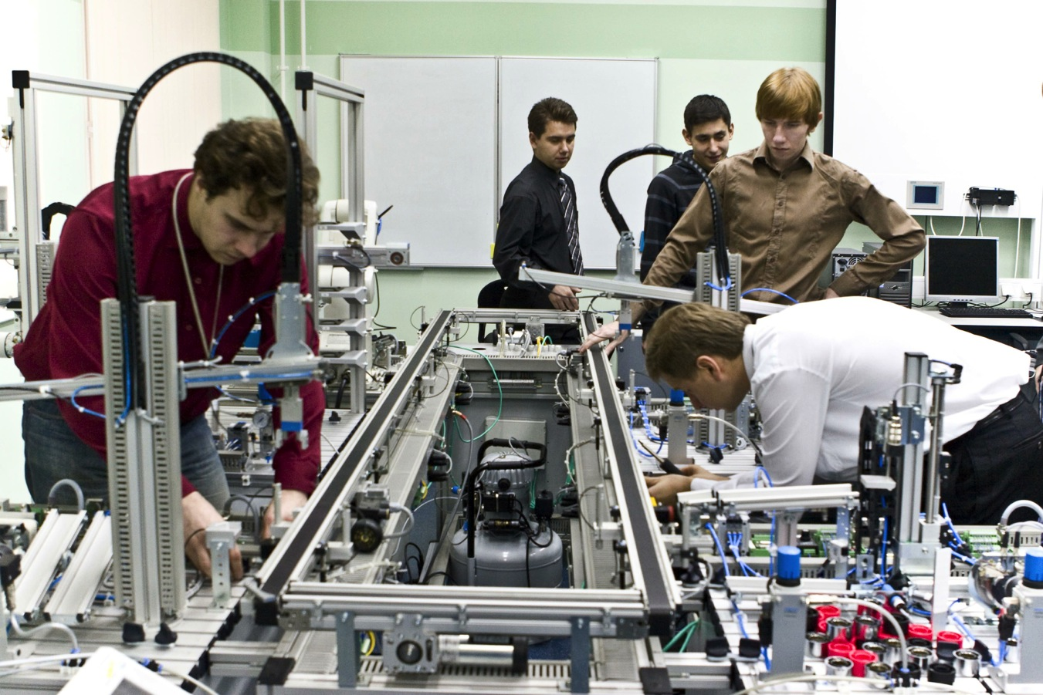
Notes:
Students in a laboratory in the Distributed Intelligent Systems Department of Saint Petersburg State Polytechnical University. Photo by AI. (CC BY-SA 3.0)

Slide 9
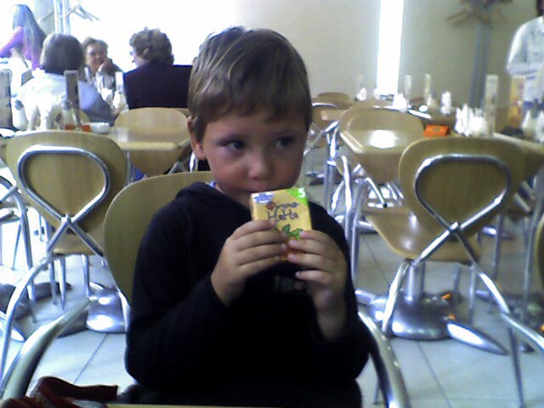
Notes:
Photo by gruntzooki. (CC BY-SA 2.0)

Slide 10
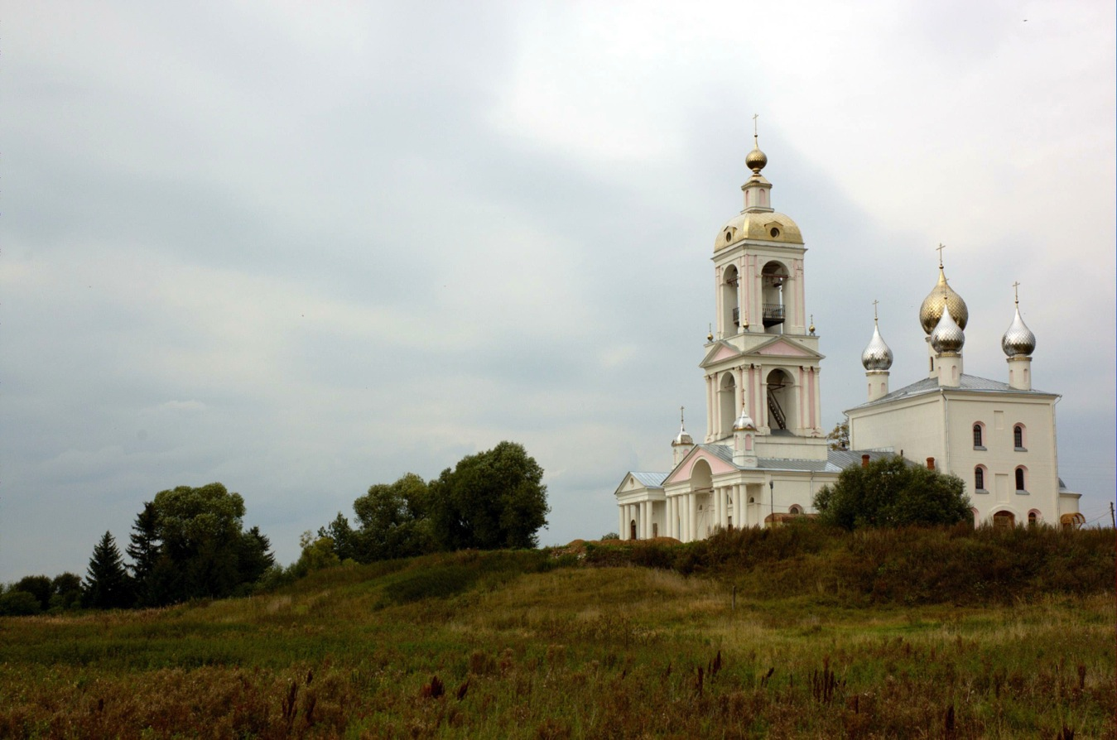
Notes:
A monastery in Zakharavo, Russia. Photo by И. Максим. (CC BY-SA 2.0) http://www.flickr.com/photos/massalim/1760976270/in/photostream

Slide 11
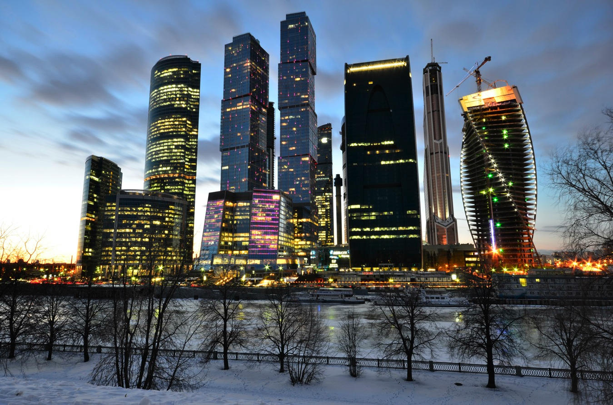
Notes:
New buildings in Moscow. Photo by Vadim Snyatkov. (CC BY-SA 3.0)

Slide 12
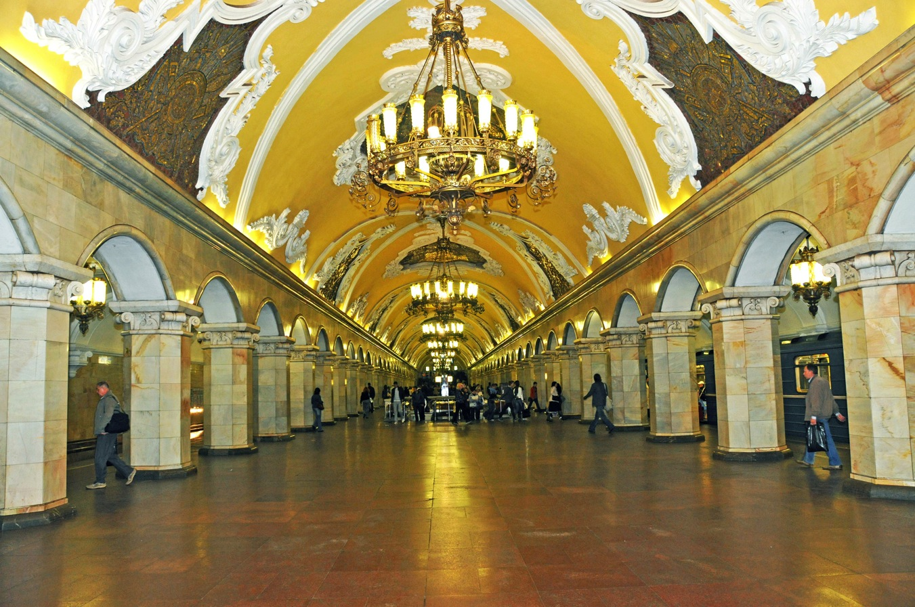
Notes:
The Moscow Metro, or subway, was built during the Soviet era. Its ornate designs were meant to demonstrate the success of the Soviet system. Photo by Dennis Jarvis. (CC BY-SA 2.0)

Slide 13
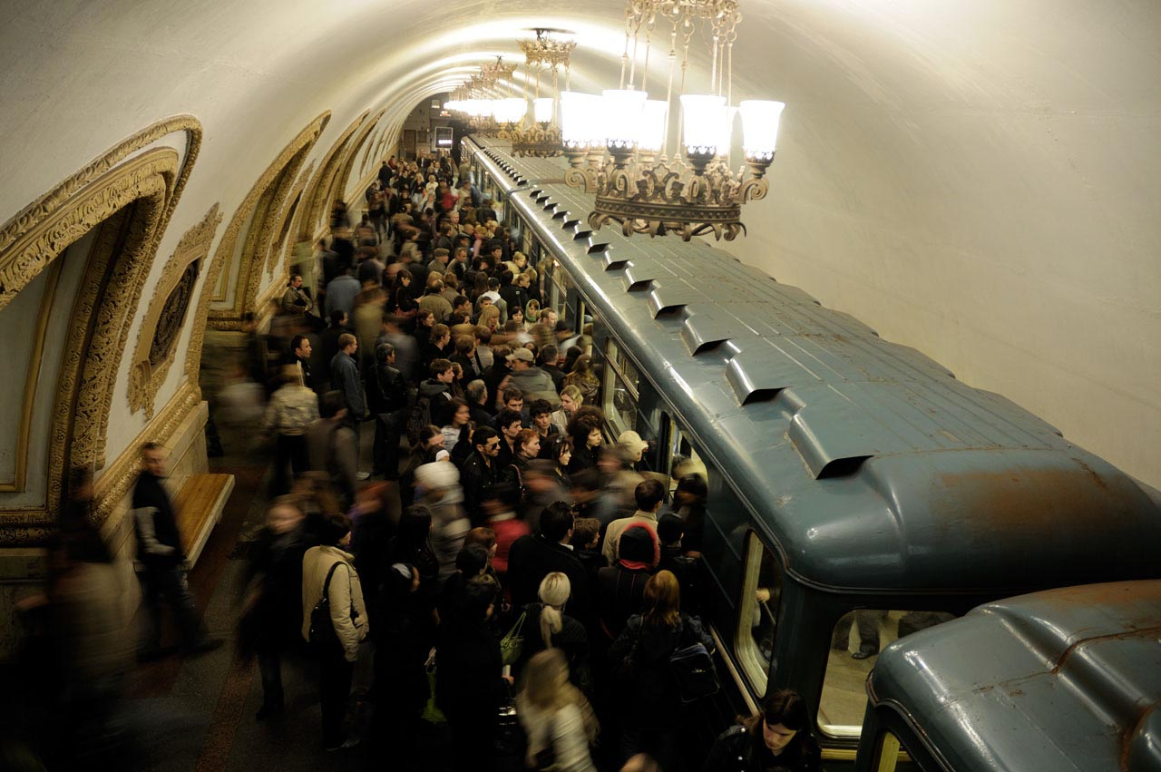
Notes:
The Moscow Metro carries more than two billion passengers per year. Photo by Christophe Meneboeuf. (CC-BY-SA 3.0)

Slide 14
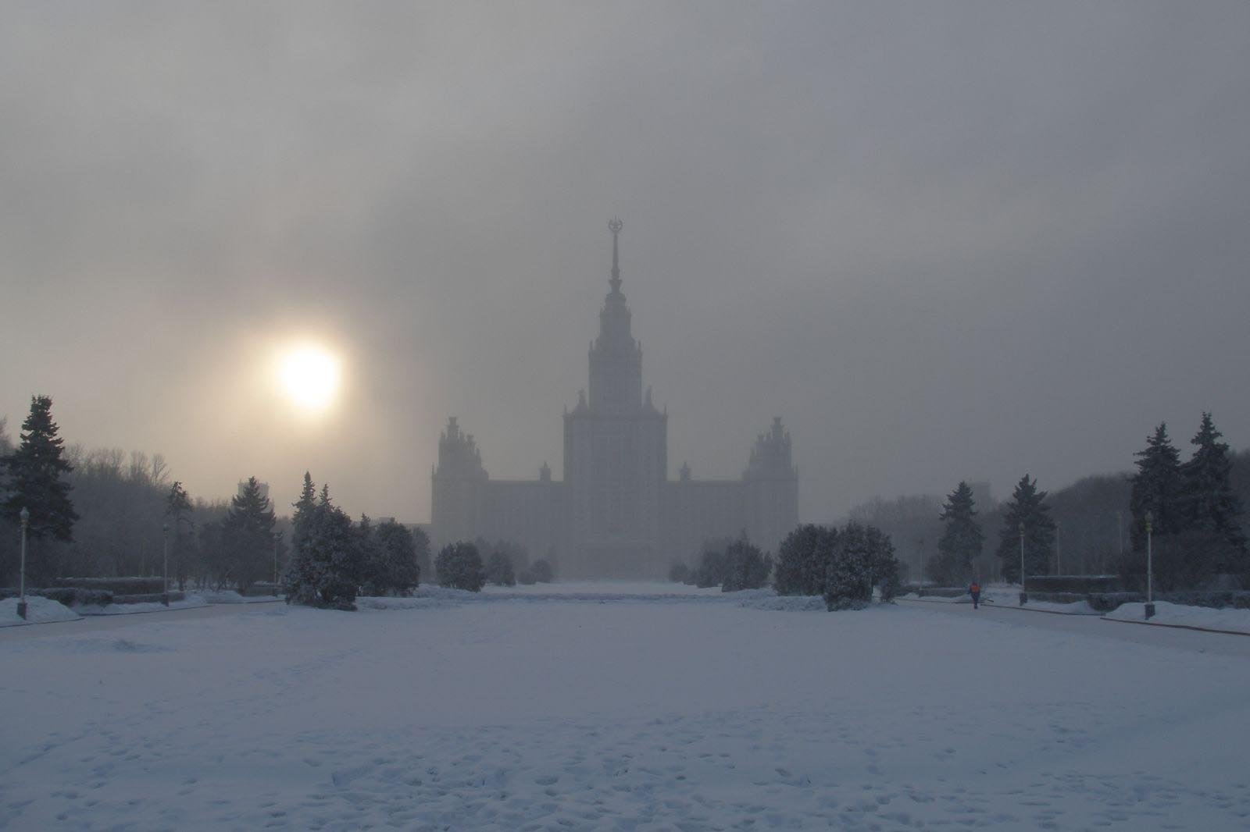
Notes:
Moscow State University. Photo by Argenberg. (CC BY 2.0)

Slide 15
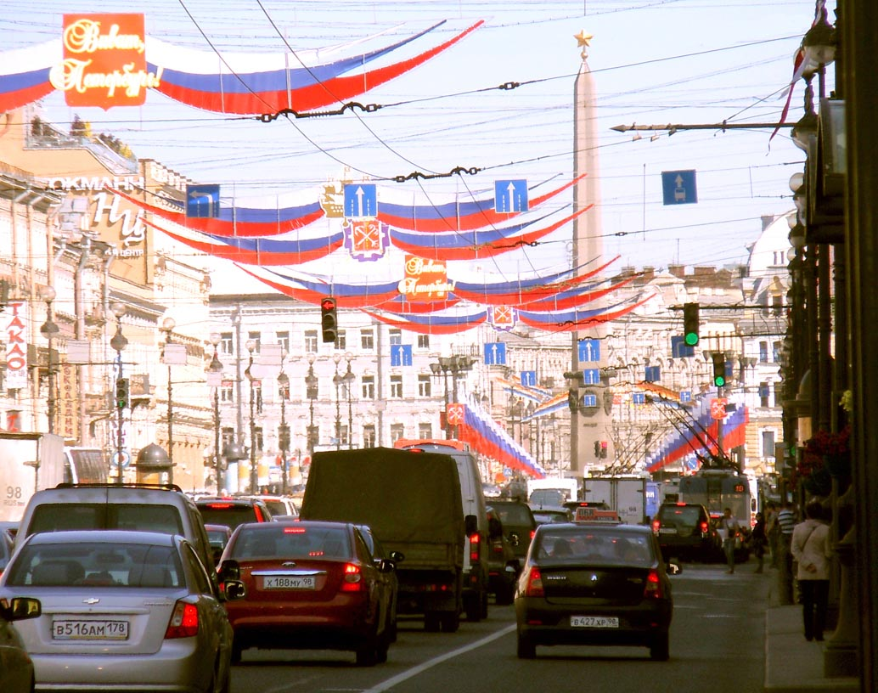
Notes:
Nevsky Prospekt, Saint Petersburg. The Hero-City Obelisk was installed in May 1985 on the fortieth anniversary of Victory Day (May 9) in World War II. Photo by Otto Frei. (CC BY-SA 3.0)

Slide 16
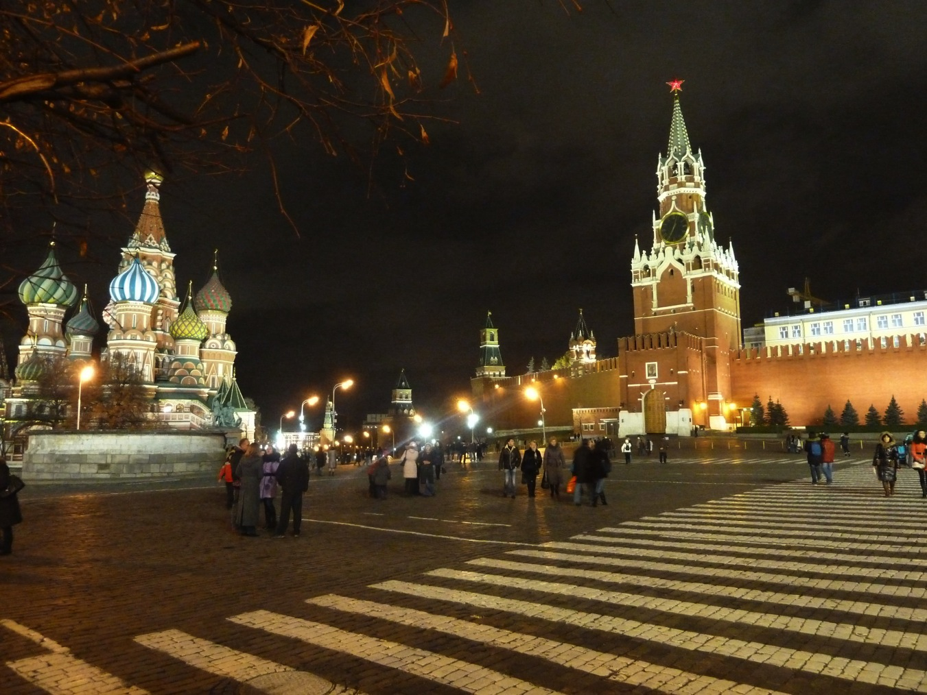
Notes:
Moscow’s Red Square at night. Photo by Deror_avi. (CC BY-SA 3.0)

Slide 17
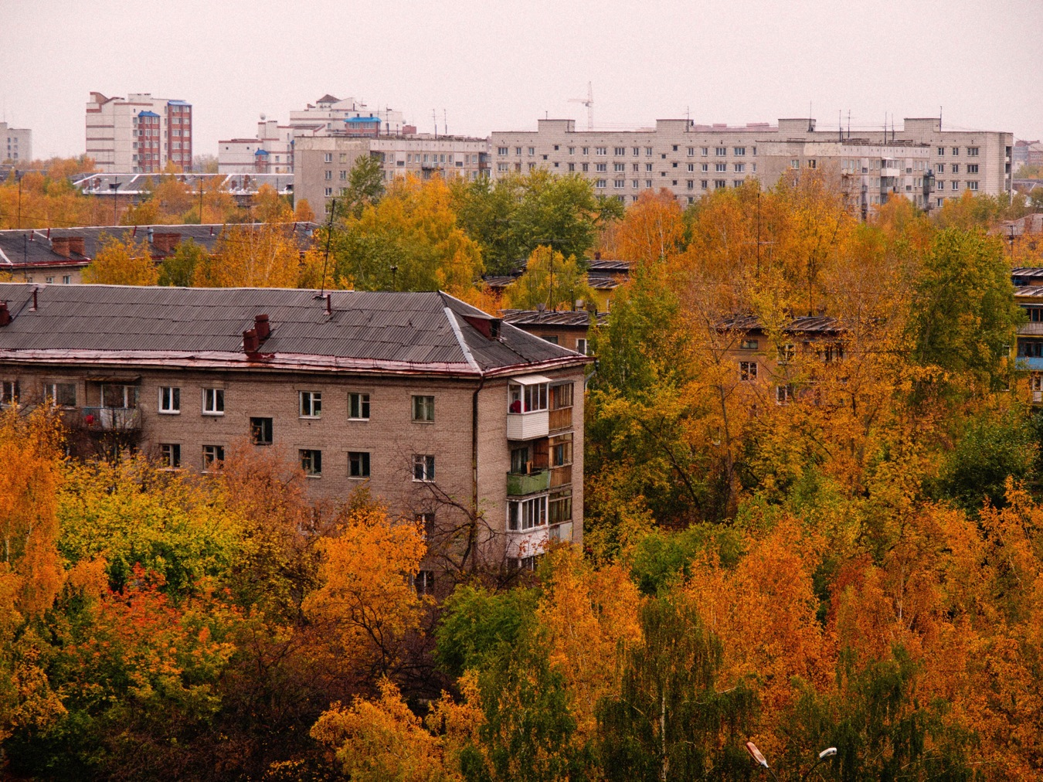
Notes:
Soviet era apartments in Novosibirsk. Photo by MIKHAIL KONININ. (CC BY 2.0)

Slide 18
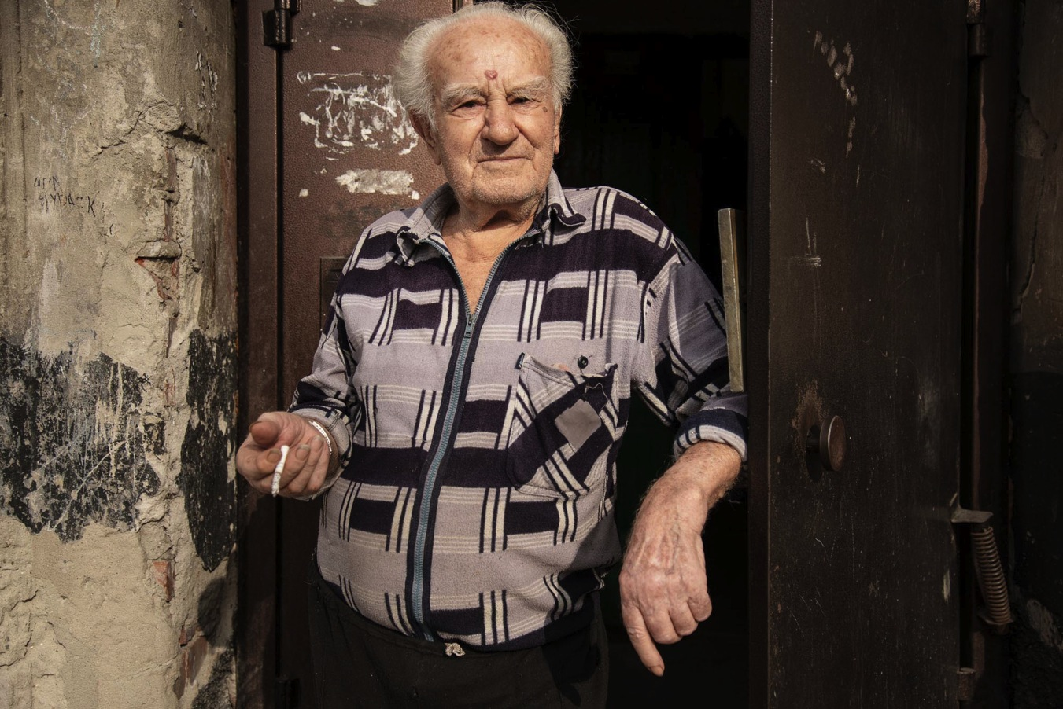
Notes:
Man in doorway. Photo by Mikhail Koninin. (CC BY 2.0)

Slide 19
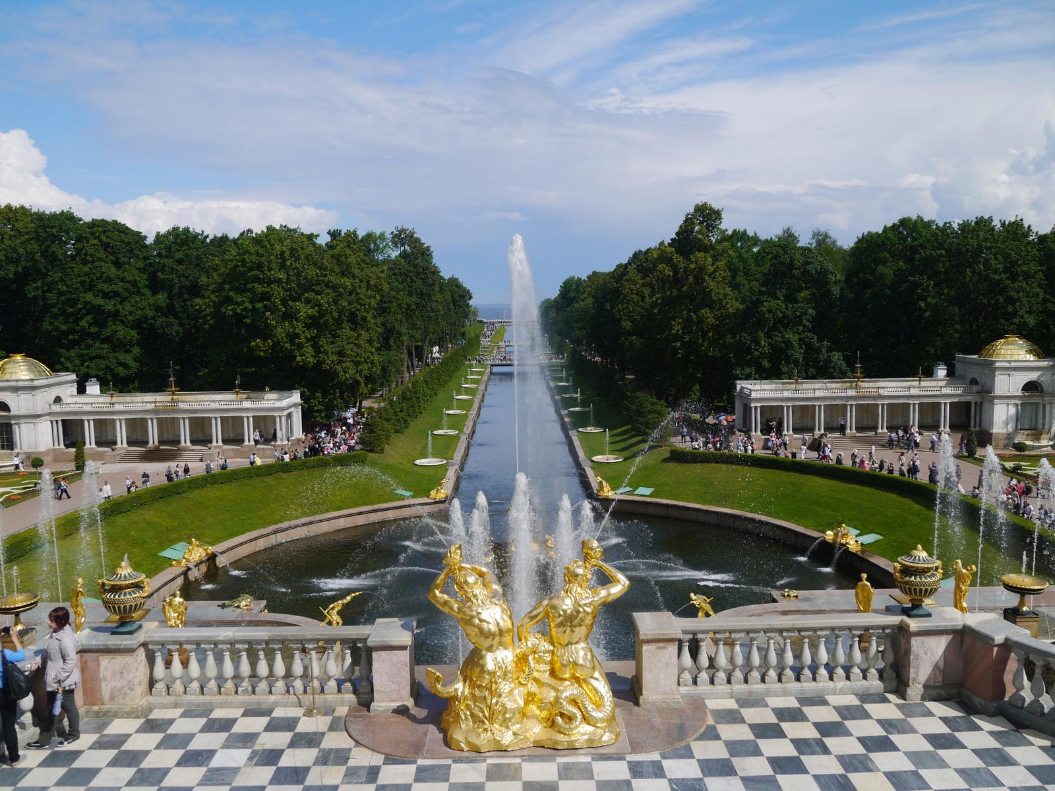
Notes:
The tsar’s summer palace near St. Petersburg. Photo by e_chaya. (CC BY 2.0)

Slide 20
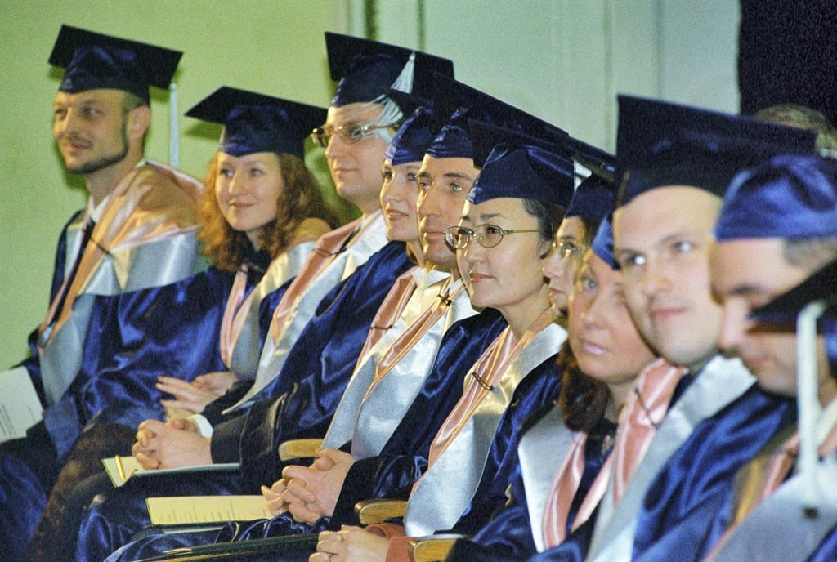
Notes:
Graduates of the Moscow University's Higher School of Business. RIA Novosti archive, image #312685 / Oleg Lastochkin / (CC-BY-SA 3.0)

Slide 21
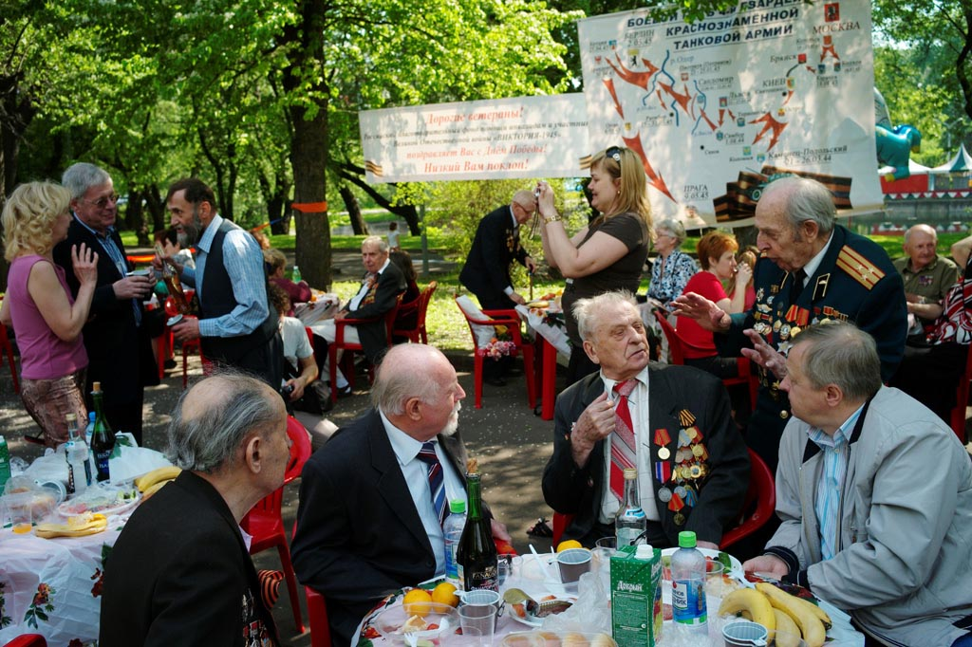
Notes:
Victory Day celebration in Moscow with veterans of World War II. RIA Novosti archive, image #660263 / Vladimir Vyatkin / (CC-BY-SA 3.0)

Slide 22
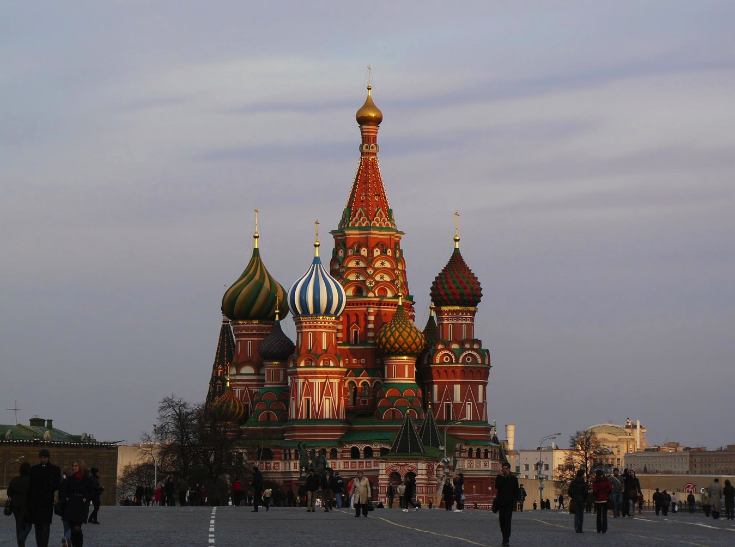
Notes:
St. Basil’s Cathedral, Moscow. Photo by Yulia K. (CC BY-SA 3.0)

Slide 23
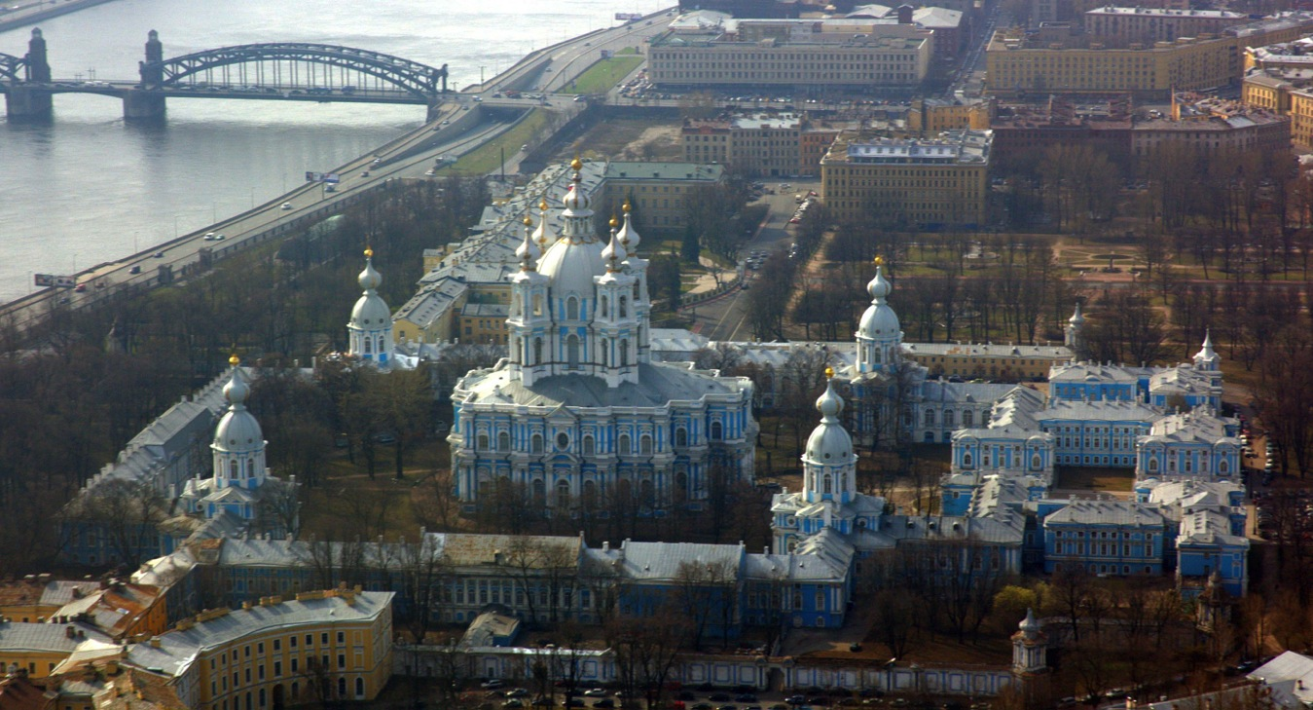
Notes:
View of St. Petersburg. Photo by И. Максим. (CC BY-SA 2.0)

Slide 24
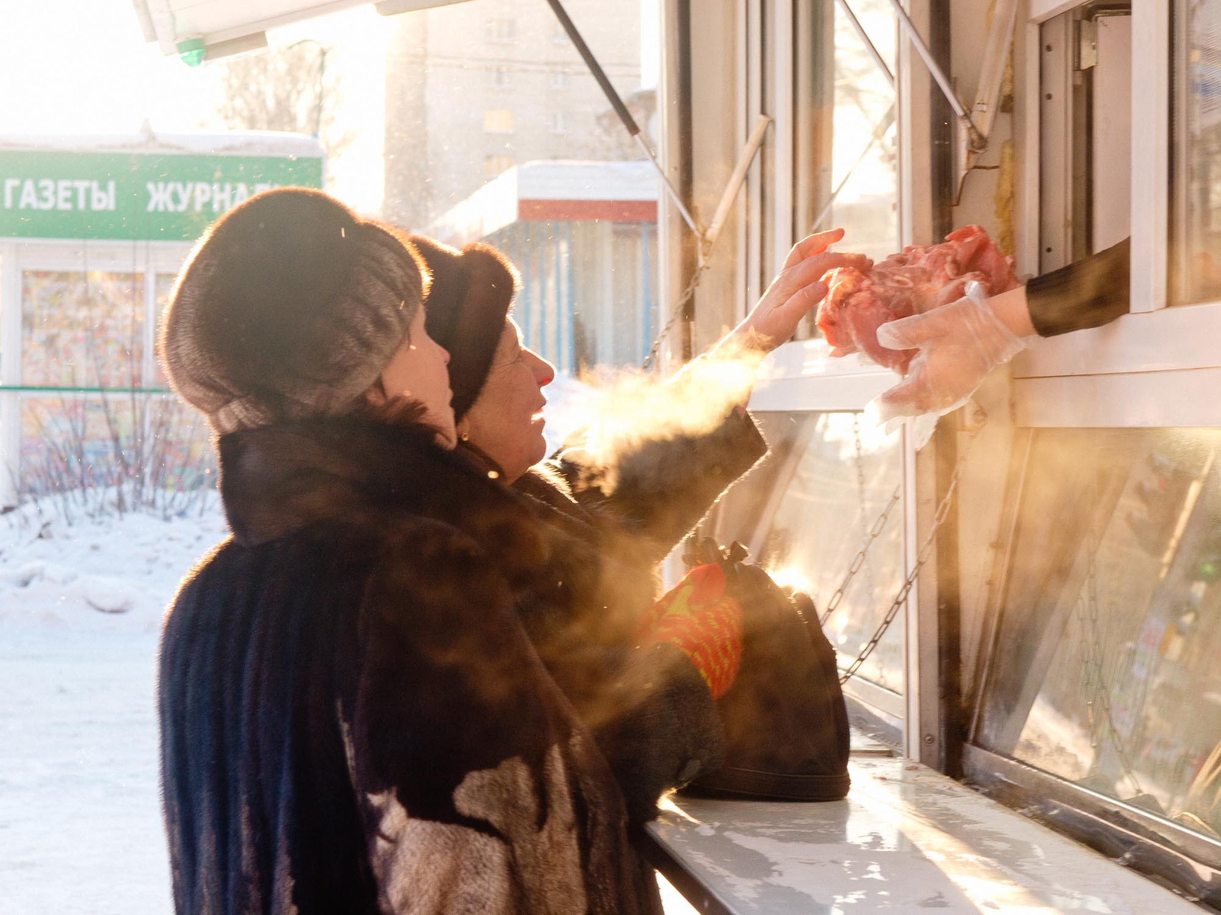
Notes:
Buying meat on the street. Novosibirsk, Siberia. Mikhail Koninin. (CC BY-SA 3.0)

Slide 25
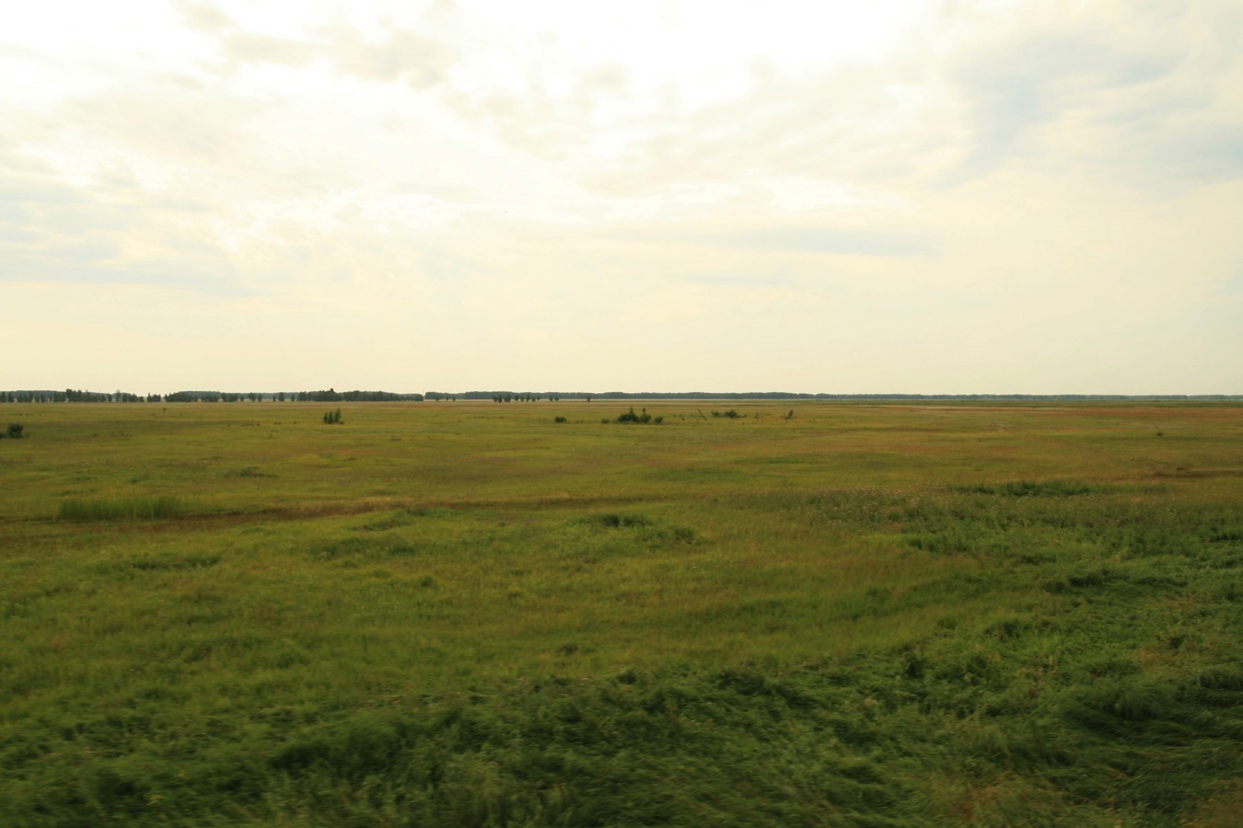
Notes:
The steppes of Siberia. Photo by Bernt Rostad. (CC BY 2.0)

Slide 26
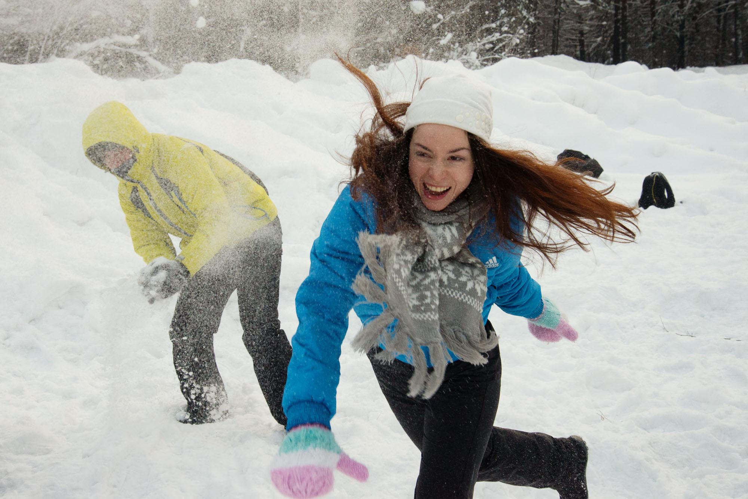
Notes:
Snowball fight. Mikhail Koninin. (CC BY 2.0)

Slide 27
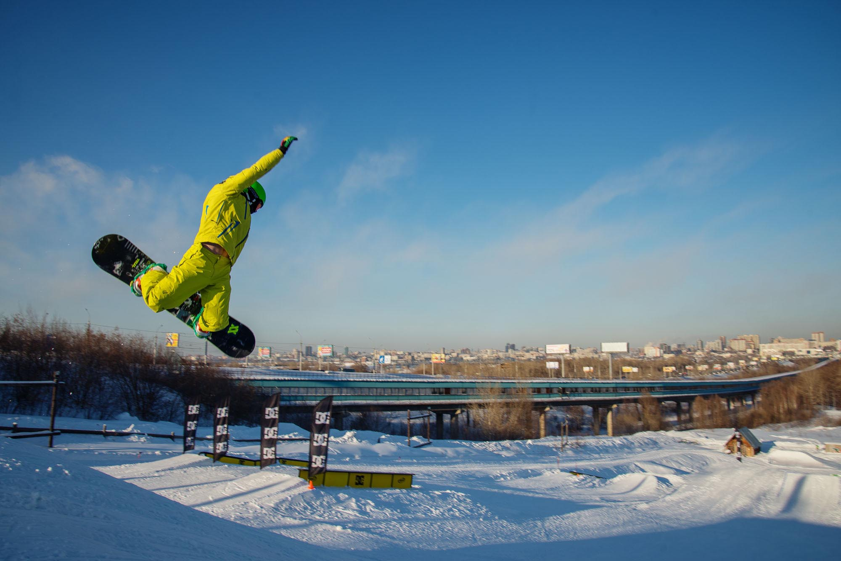
Notes:
Photo by Mikhail Koninin. (CC BY 2.0)

Slide 28
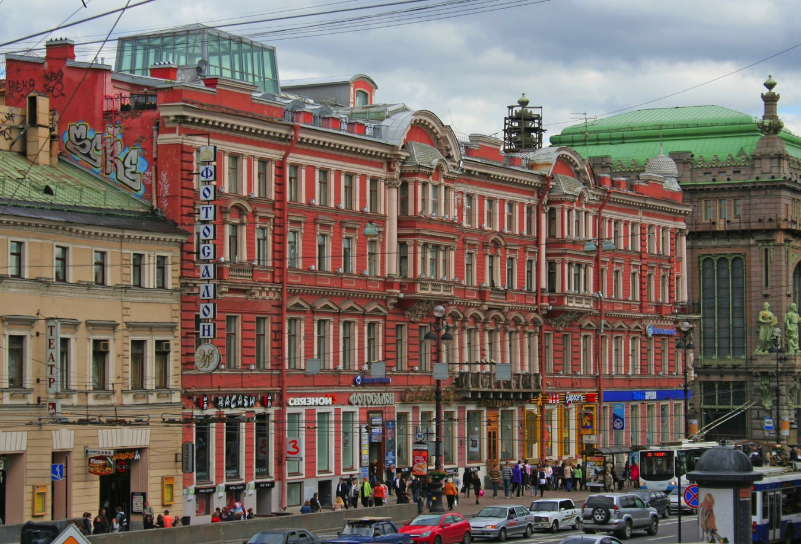
Notes:
The Nevsky Prospekt in Saint Petersburg. Photo by A.Savin. (CC BY-SA 3.0)

Slide 29
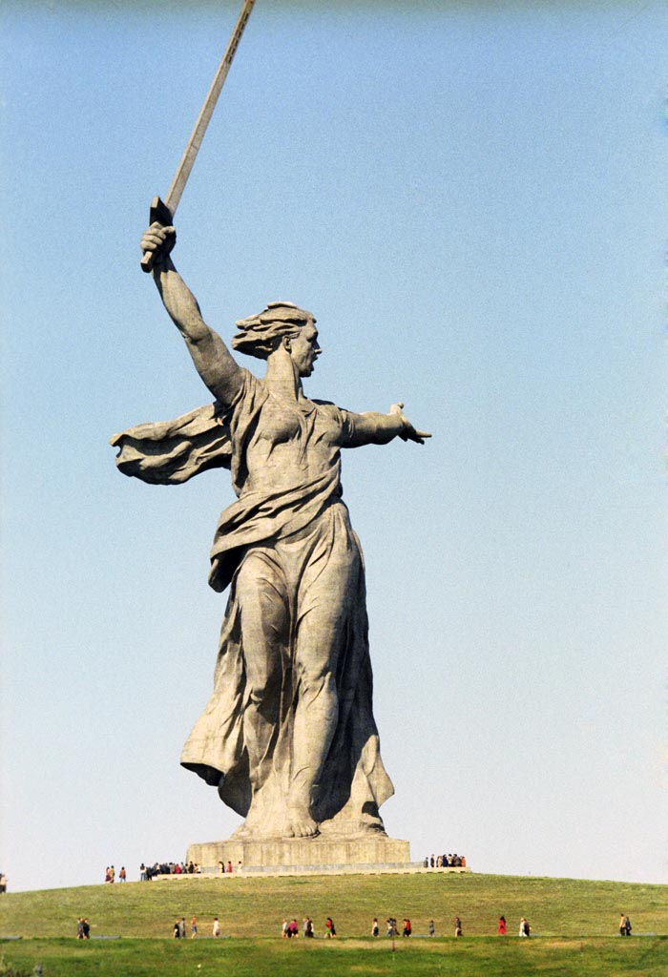
Notes:
“The Motherland Calls” by sculptor Yevgeny Vuchetich. The sculpture commemorates the Battle of Stalingrad, and stands 279 feet tall. Photo by Boris Babanov. (CC BY-SA 3.0)

Slide 30
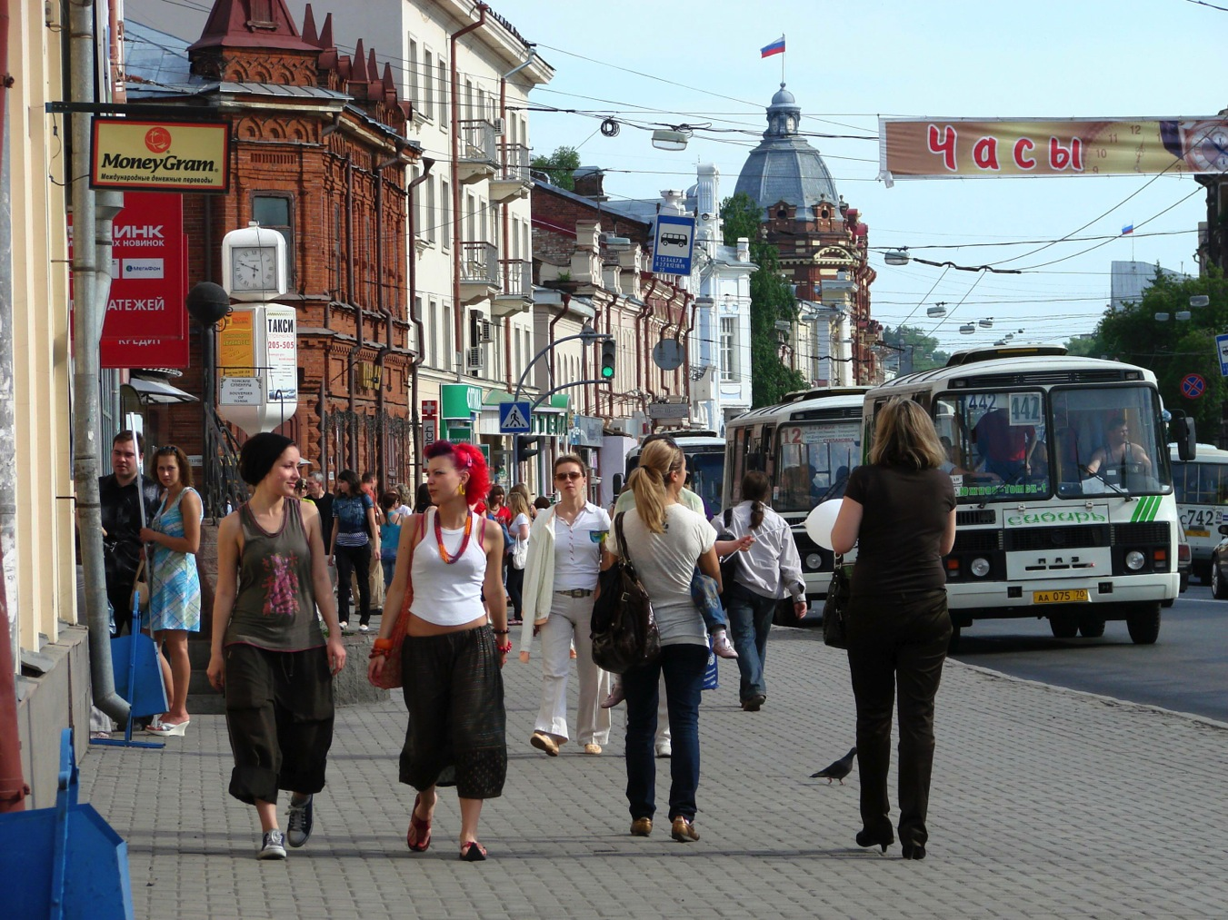
Notes:
Tomsk, Siberia. June 2008. Photo by Adam Jones. (CC BY-SA 3.0)

Slide 31
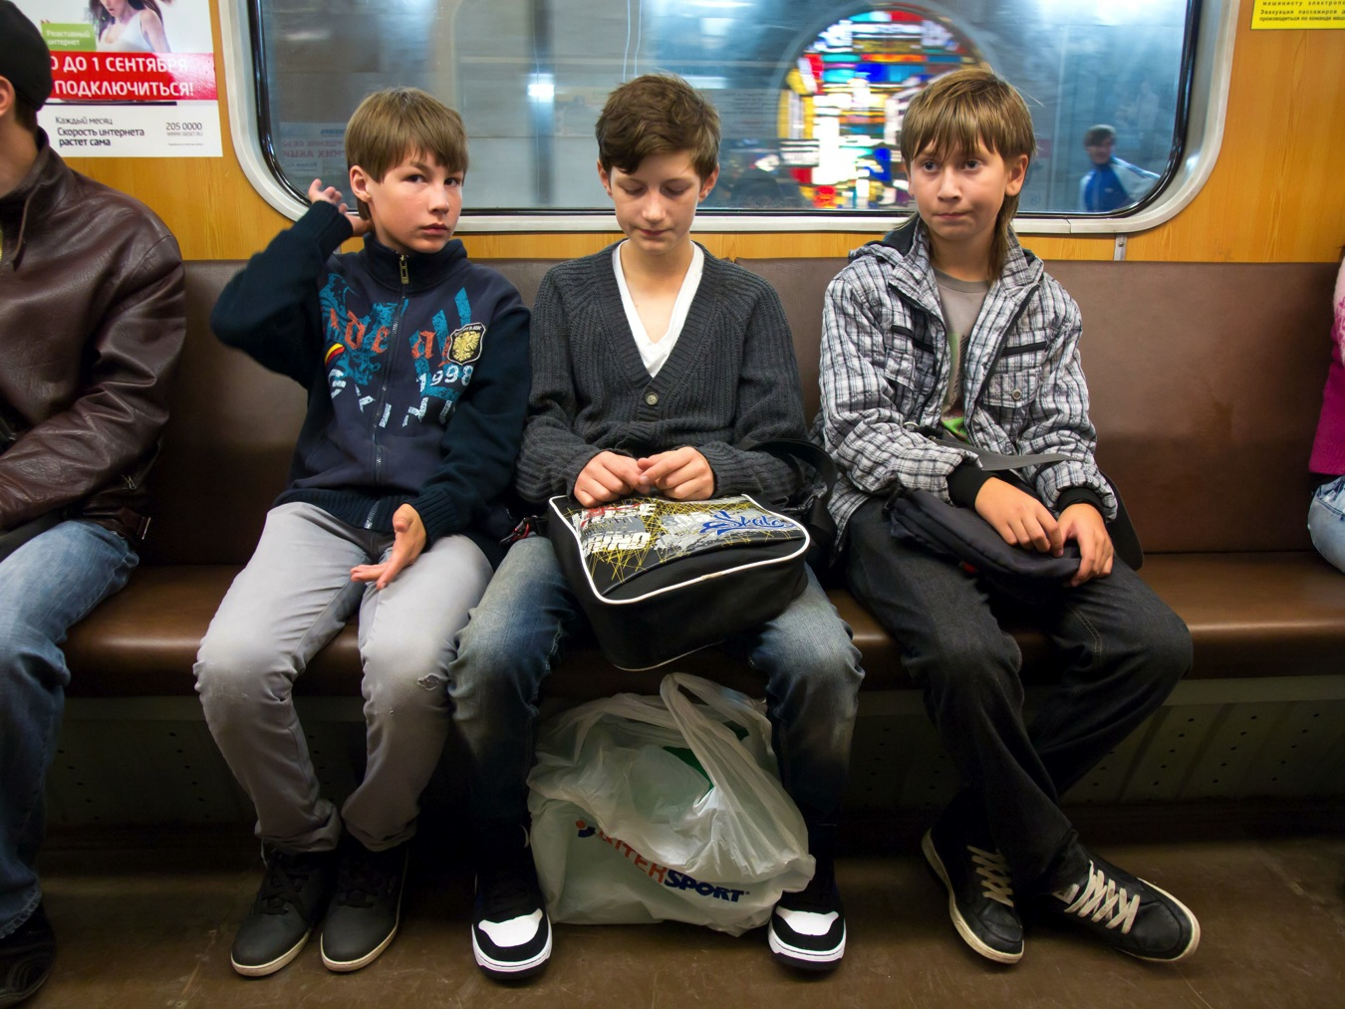
Notes:
A subway train in Novosibirsk, Siberia, August 2011. Photo by Mikhail Koninin. (CC BY 2.0)

Slide 32
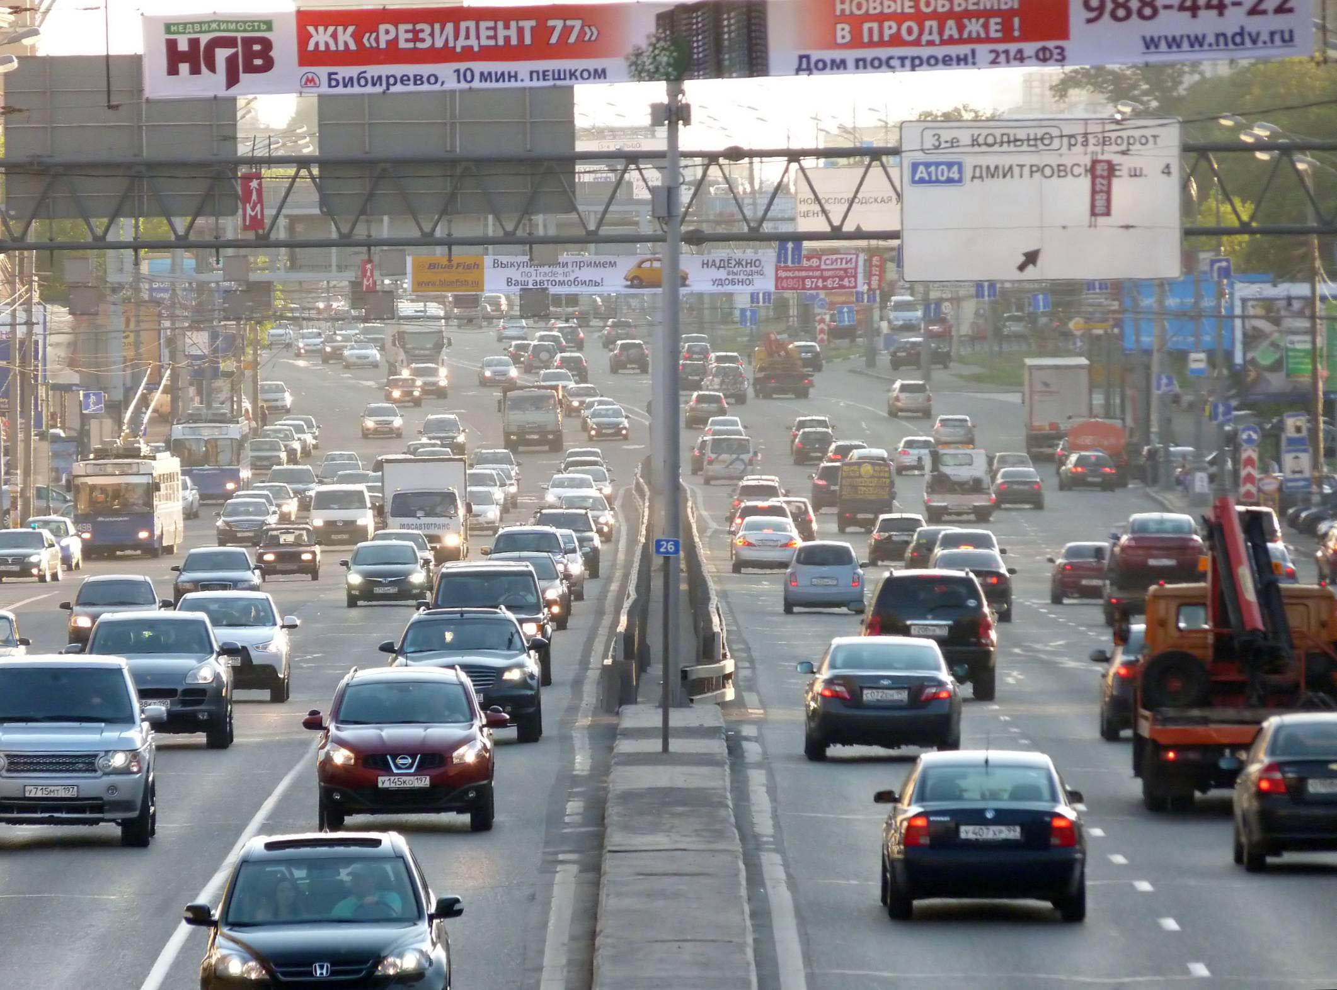
Notes:
Sushchyovsky Val Street, Moscow. Photo by Emaus. (CC BY-SA 3.0)

Slide 33
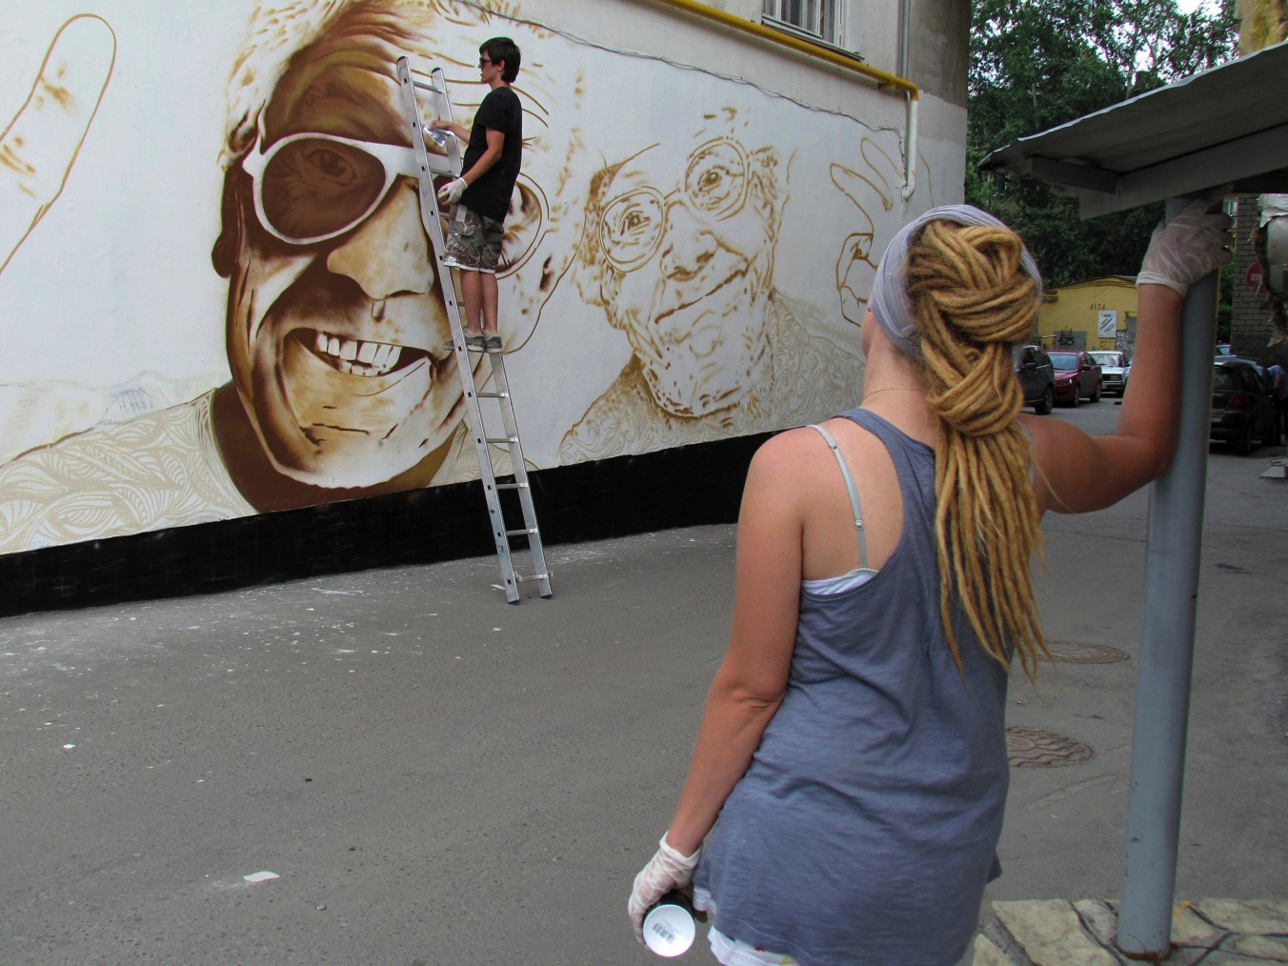
Notes:
Work by the “Tak Nado!” crew in the 2011 Stenograffia Street Art & Graffiti Festival in Yekaterinburg. Photo by Etaskina. (CC BY-SA 3.0)

Slide 34
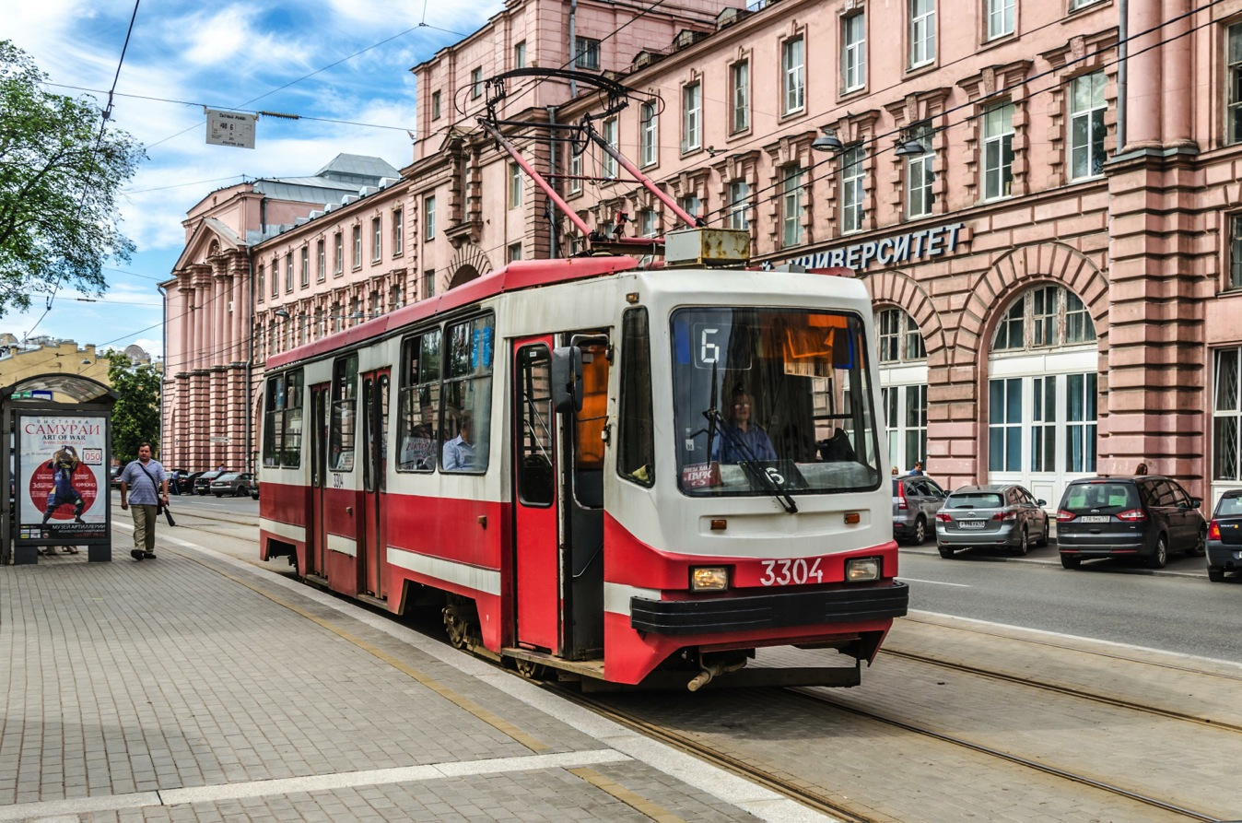
Notes:
A tram in Saint Petersburg. Photo by Florstein. (CC BY-SA 3.0)

Slide 35
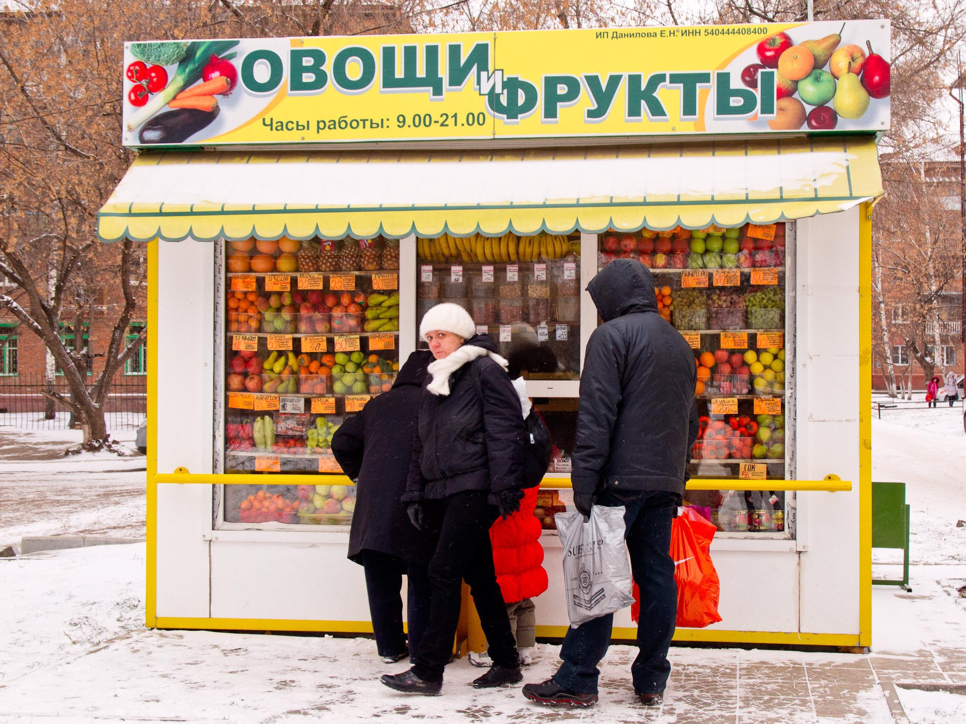
Notes:
A fruit and vegetable booth in Novosibirsk, Siberia, 10.11.2011. Photo by Mikhail Kononin. (CC BY 2.0)

Slide 36
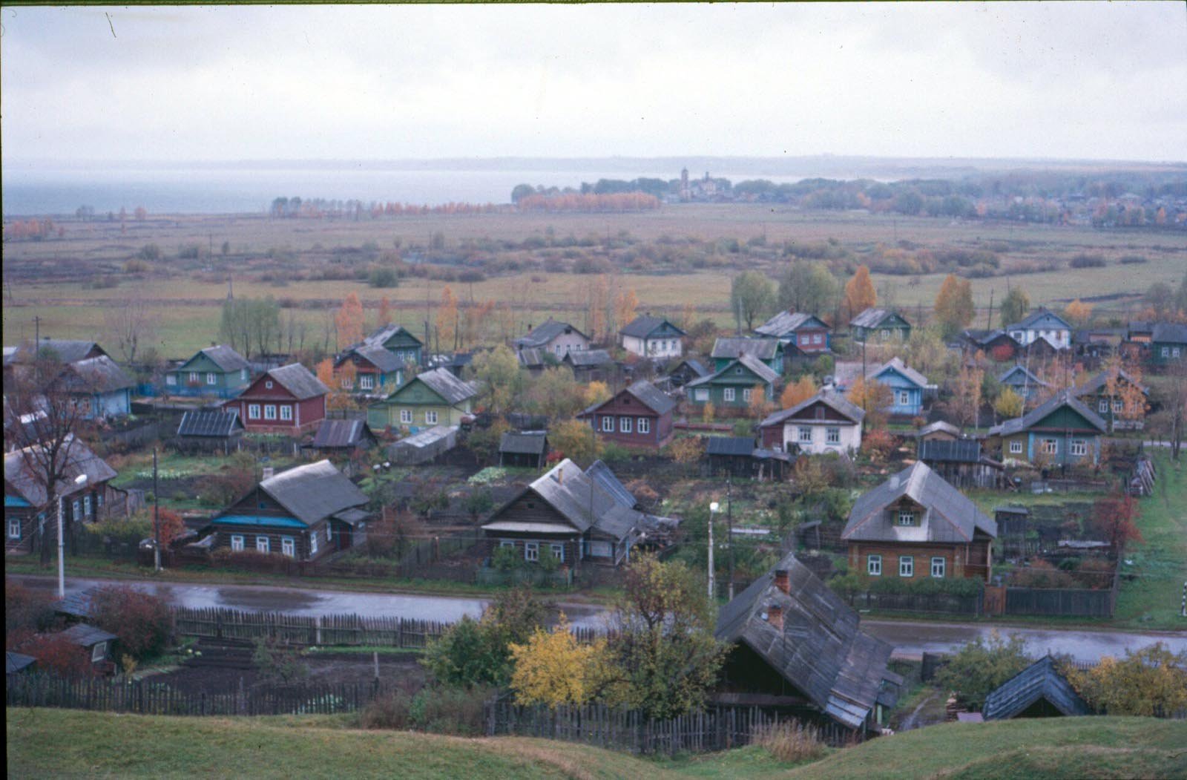
Notes:
A Russian village. Photo by Christopher Bulle. (CC BY 2.0)

Slide 37
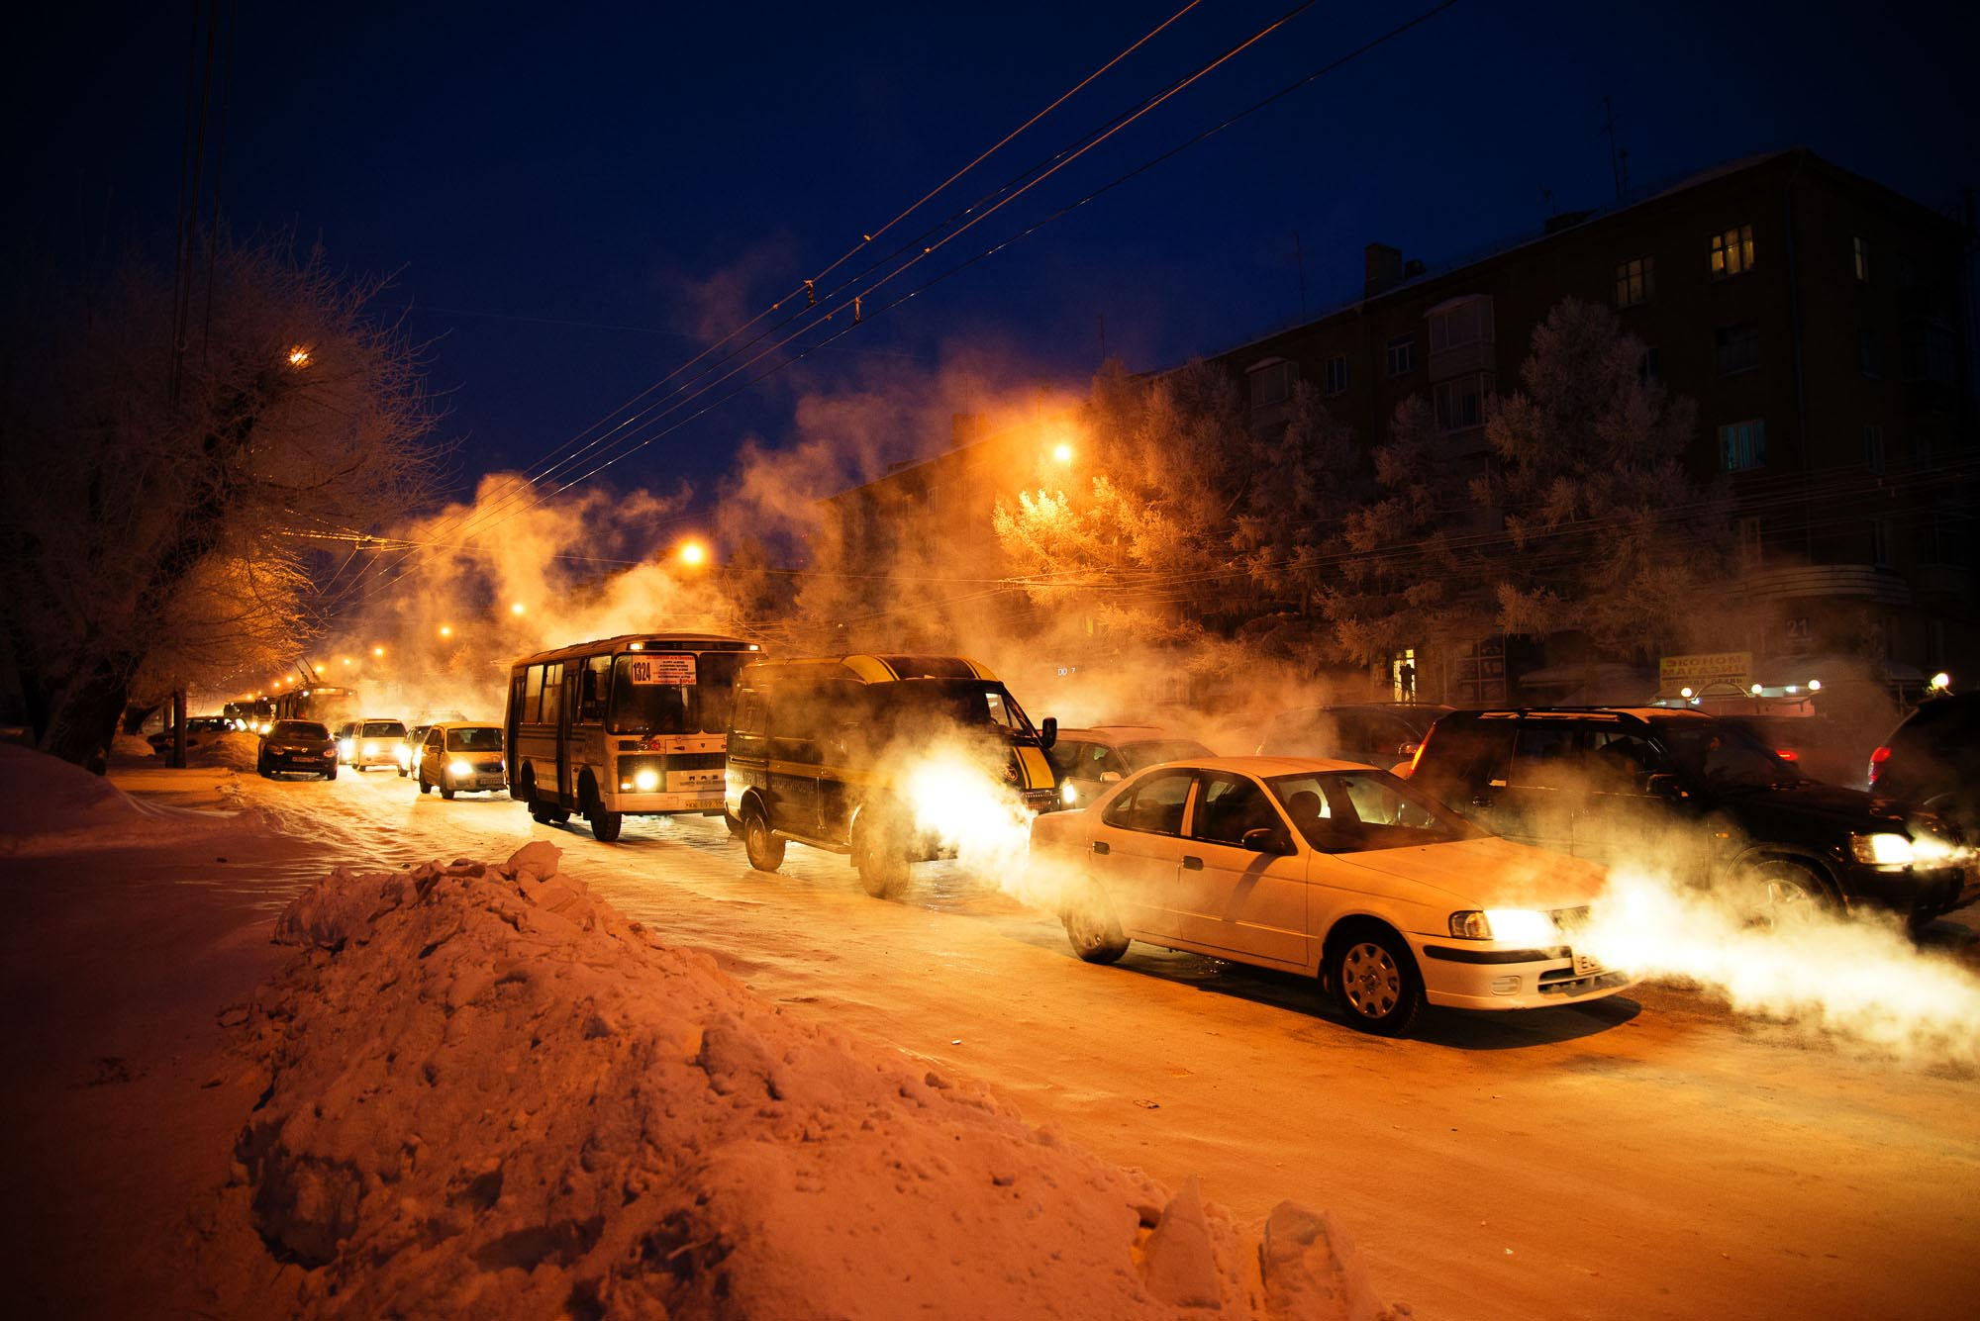
Notes:
A winter traffic jam in Novosibirsk. Photo by Mikhail Kononin. (CC BY 2.0)

Slide 38
Notes:
Young women outside Kazan University, Kazan, Russia. June 2008. Photo by Adam Jones. (CC BY-SA 2.0)

